Slide 1

Medall Healthcare Private Limited – Chennai, Tamilnadu
TRANSACTION DETAILS:
EQUIPMENT TERM LOAN : INR 500.80 LAKHS EXCLUSIVE OF INSURANCE LTV – 80% FOR 4 CT EQUIPMENT WITH 60 MONTHS TENURE. TOTAL EXPOSURE – 578.83 LAKHS.
OR
EQUIPMENT TERM LOAN: INR 563.40 LAKHS EXCLUSIVE OF INSURANCE LTV – 90% FOR 4 CT EQUIPMENT WITH 48 MONTHS TENURE. TOTAL EXPOSURE – 640.97 LAKHS
EQUIPMENT TOTAL PRICE: INR 626 LAKHS
REGISTERED ADDRESS: 191,POONAMALLEE HIGH ROAD, KILPAUK CHENNAI TN 600010
ASSET CATEGORY: CATEGORY A.
LOCATION CATEGORY CATEGORY A.
CUSTOMER CATEGORY: CATEGORY C.
APPLICATION ID: SCDHFS0000141087, SCDHFS0000141434, SCDHFS0000141439

Slide 2

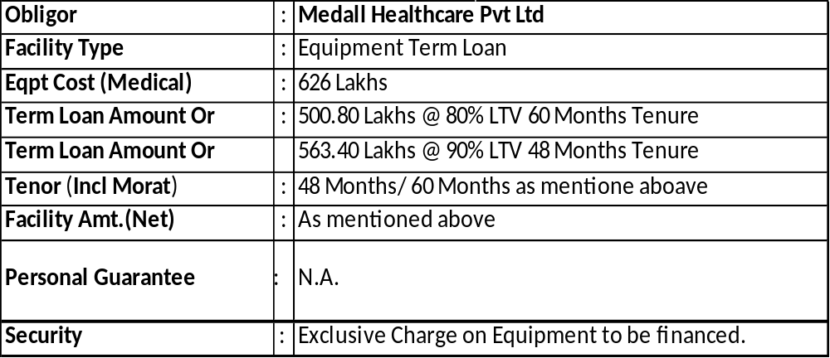
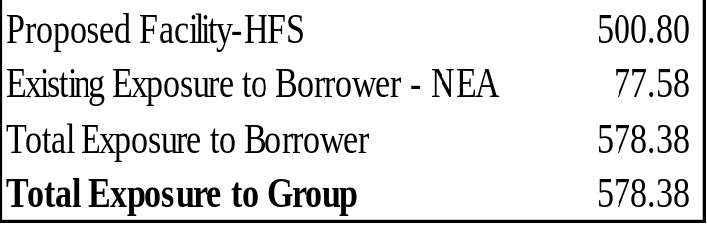
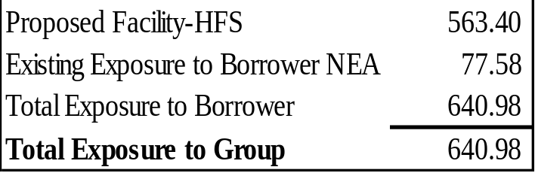
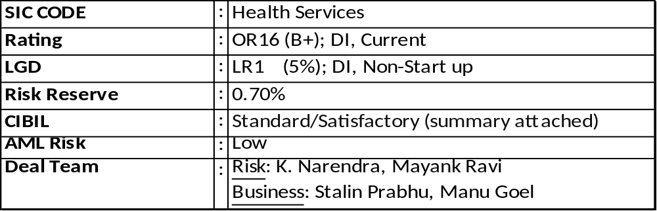
HFS – June 2022
MEDALL HEALTHCARE PRIVATE LIMITED
HFS term loan of INR 500.80 Lakhs with 80% LTV for 4 CT Equipment with 60 Months tenure – Total Exposure – 578.83 Lakhs. (Or)
HFS Term Loan of 563.40 Lakhs with 90% LTV for purchase of 4 CT Equipment with 48 Months tenure.
Equipment Cost INR 626 Lakhs.
Deal Summary
Exposure
Exit Strategy
Obligor Cash-Flows
on default. Repossession and re-sale of equipments financed.
GE Buy back enforcement.
Or

Slide 3
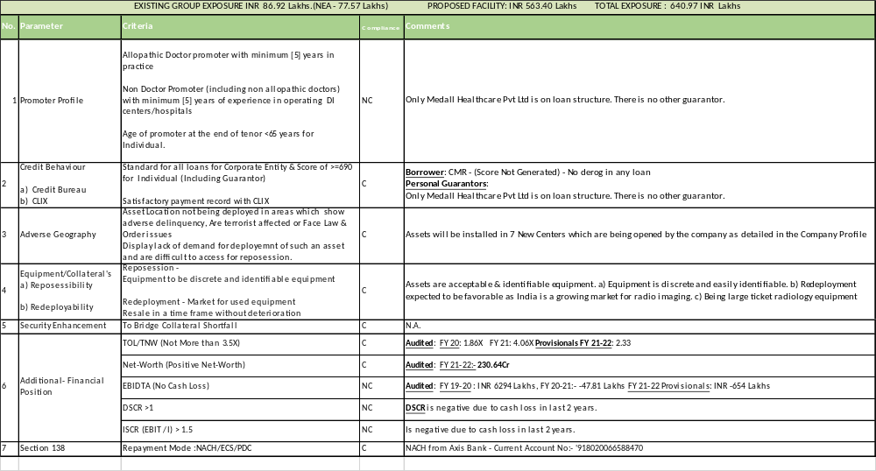

Slide 4
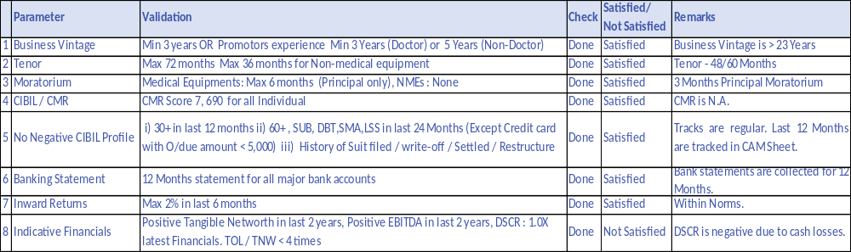
HFS – June 2022
POLICY RUN PARAMETERS
Due Diligence Checks and Ratings
SIC Industry | Health Services | SIC Code |  | 8000 | Delinquency | Current | Customer Type | DI
Client Categorization-AML Risk | Medium | Location Categorization |  | Category A | OR Rating | OR15 | LCG Proxy | Other,Non Start-up
Asset Size (Plant and Machinery) | Category A | Letter Equivalent |  | B+ | LR Rating | LR1 | LGD % | 5%
Rating | OR15 (B+) , Current, DI | LGD | LR1 (5%), Other,Non Start-up |  | Risk Reserve | 0.71% | AML Risk | Medium
Hospital Type | Diag Centre without MRI/CT/Hospital/ Nursing Home <50 beds | Business Type | Type B |  | Customer Segment | Core | CUSTOMER CATEGORY | Category C

Slide 5
HFS – June 2022
Entity Profile – Medall Healthcare Pvt Ltd
Medall Healthcare Pvt. Ltd (MEDALL) is South India’s largest chain of medical diagnostic services.
They are among the largest independent and “integrated "diagnostic service providers, which include both Pathology tests and Radiology Imaging.
Precision Diagnostics Pvt Limited (PDPL) was incorporated in 1994 in Chennai and Medall Healthcare Pvt Ltd (MHPL) acquired 100% stake in PDPL in 2009.
The company have regional laboratory network with 26 apex labs, 160 distributed / satellite / special clinical laboratories and more than 7,850 customer touch points.
The multi-format touch point entails radiology centers, company owned pathology centers, franchisee managed pathology, captive centers, Radiology Public Private Partnerships (“PPP”), Pathology PPPs and L2L (lab to lab)
The company mainly concentrate at “hub and spoke” model, whereby specimens are collected across multiple locations that are being served by regional processing labs, provide greater economies of scale and offer a scalable platform for the continued growth of the business in a sustainable manner.
The Medall group is one of the top five service providers in the highly fragmented diagnostics services industry with a wide network of centers across South India. The group's operation were impacted during the month of April due to COVID-19 lock down; however business resumed to normalcy with sales returning to pre-covid levels supported by gradual increase in footfall, wide spread home sample collection network supporting its operation during the time of pandemic and increase in COVID Testing.
Medall have 223 company owned centers, 250 franchisee centers, 32 government contract centers in Jharkhand and 128 lab to- lab collection points. Medall have active commercial relationships with the State governments of Jharkhand.
The company did not renew the PPP Agreement with Andhra Pradesh Government. This revenue is 80Cr per annum. Now they are replacing 4 Centers CT Equipments with New CT Equipment.
The revenue mix of Medall group primarily consists of walk in customers who are referred by doctors. These customers pay cash up front for the services being availed.
The group has a large referral network of doctors.
Over the years the group has followed the strategy of entering new markets by acquisition of locally reputed diagnostic center and establish it as a Hub. Later the group also has grown organically by setting up spoke locations and collection centers.
The franchises being opened are almost fully Lab collection centre /Stores. Hence there will not be any lab equipment in the store . The Franchisee maintains a small deposit with Medall, bills the customer and Medall’s share is adjusted on a daily basis against Medall Share . The revenue percentage depends on the type of test ,ranging from 50 % to 80% for Medall. The processing is done at Medall labs.

Slide 6
HFS – June 2022
Projections Details
Medall Healthcare Private Limited,Chennai
Profit & Loss Account
 |  | In INR Mn
FY Ending |  | Mar-23
Revenue from operations |  | 3,358
% growth |  | 52%
Marketing Cost |  | 570
 |  | 17%
Professional Cost |  | 336
 |  | 10%
Employee Cost |  | 508
 |  | 15%
Supplies |  | 517
 |  | 15%
Facilities |  | 320
 |  | 10%
Others |  | 67
 |  | 2%
Total Cost |  | 2318
 |  | 69%
Operating EBITDA b/f Corp OH |  | 1040
% |  | 31%
Corp OH |  | 315
 |  | 9%
Operating EBITDA a/f Corp OH |  | 725
 |  | 22%
One of expenses |  | 9
Other Income |  | 0
EBITDA after one of expenses |  | 716
 |  | 21.3%
Depreciation |  | 490
EBIT |  | 226
 |  | 7%
Finance Cost |  | 196
PBT |  | 30
 |  | 1%
Tax Expense |  | 0
Other Comprehensive Income |  | -
Minority Interest |  | -
PAT |  | 30
 |  | 1%
Given Projections is gross figures as discussed with accounts team of Medall Healthcare Pvt Ltd.
Expected Net turnover will be 285Cr in FY 22-23.
Financials Up to FY 21-22 are post IndAS. Finance costs include Operating lease expenses and Long Lease on Properties. Due to this finance costs are 37Cr.
Fy 23 projections are before IndAS and Interest cost projected at 19 Crs and they are aiming to bring it close to Rs.15 Crs once the large receivables from the government start coming in.
Hence they are projecting no cash loss in FY 23.
They are now opening Franchisee centers from 15 – 20 in a Month. There is up front one time fee received per center in the range of 2-3 Lakhs.
The franchises being opened are almost fully Lab collection centre /Stores. Hence there will not be any lab equipment in the store . The Franchisee maintains a small deposit with Medall, bills the customer and Medall’s share is adjusted on a daily basis against Medall Share . The revenue percentage depends on the type of test ,ranging from 50 % to 80% for Medall. The processing is done at Medall labs.
These franchisee being open are like collection centers for Medall Diagnostics. Samples are collected from these centers at regular intervals.
Turnover expected in FY 22-23 is more as there will be new equipment advertising in the Medical Community.
10% Business loss earlier is due to machine downtime. Now due to new equipment being installed downtimes will not be there for 2 years at least in the beginning.
Company got 25Cr Infusion on 23-06-2022 which will be spent for more advertising and Brand Management.
Earlier due to working capital issues after COVID 19 all the labs are not stocked 100% for consumables and chemicals and materials used. Now 99% Stocking is done for all the pathological labs. This will keep them best prepared now for increase in revenue and servicing.
Feedback from doctors on Packages to customers for testing services will be more now going forward.

Slide 7
HFS – June 2022
Projections Details and Capital Infusion Usage Details
Branding and advertising activities will increase due to 25Cr Capital infusion. They are expecting more turnover due to these activities.
There are some loans which will be closed by year end. Loan from Axis Bank will be closed by Year end. Loan from Vivriti Capital will be closed which is 20Cr Loan by end of year. There is 6Cr Deposit amount which will be adjusted and this facility will be closed by year end.
By next year the obligation outflow will be 30Cr annually. This will decrease the expenses for the company.
Ash Investments PTE Ltd has infused a Capital of 150Cr in 2 Tranches in Medall Healthcare Private Limited. 125Cr capital was infused in 24th March 2022. 25Cr Capital was infused on 23-06-2022.
Shareholding after infusion now will be in the range of 51% - 52% for Ash Investments PTE Ltd in Medall Healthcare Pvt Ltd.
Avani Pvt Ltd and Peepul Capital Fund shareholding will be around 40%. Avani is group company of Peepul Capital as discussed with CFO.
Ash Investments PTE Ltd belongs to Gateway Partners. Gateway partners invested > 1000 Million in 30+ Countries with 17 Portfolio companies. Medall Healthcare Pvt Ltd is reflecting in Investments page of Gateway partners. Other Indian Companies are TVR Supply Chain Solutions and GMR Infrastructure is seen in the portfolio list of Gateway Partners.
Salary payments for employees with packages ranging from Rs. 30 Lakhs to 1.5Cr were held back for 4 – 5 Months due to working capital expenses and expected capital Infusion. Once the capital infusion is received all the dues were cleared including the Full and Final Settlement of employee who left the organization. 4Cr of Bonus distribution was also completed. There are 50-60 People in this category. Below is the capital infusion utilization.
 | Rs in Crs
 |  | Due | Paid
Statutory Payments Up to Date Including Interest | 15.00 | Q2 to Q4 | Paid in Mar 22
Corporate Tax Appeal And Assessment Amounts | 7.00 | Payable in Mar 22 | Paid in Mar 22
Vendor Payments Supplies ,Services | 10.00 | Payable from Dec 21 to Mar 22 | Paid in Mar 22 & Apr 22
Pending Revenue Shares | 4.00 | Payable from Feb 22 & Mar 22 | Paid in Mar 22 & Apr 22
Capex And Advertisement/Branding | 4.00 | Payable from Dec 21 to Mar 22 | Paid in Mar 22 & Apr 22
Cmc | 5.00 | Q3 & Q4 | Paid in Mar 22 & Apr 22
Rents | 4.00 | Q3 & Q4 | Paid in Mar 22 & Apr 22
Services And Capital Creditors | 3.50 | Payable from Nov 21 to Mar 22 | Paid in Mar 22 & Apr 22
Employee Related Payment | 13.25 | Payable from Dec 21 to Mar 22 | Paid in Mar 22 & Apr 22
Franchisee Payments | 6.00 | Q3 & Q4 | Paid in May 22
Franchisee Refunds | 5.00 | Q3 & Q4 | Paid in May 22
Debt Reduction And Interest Servicing | 39.00 | Payable in Q4 & Apr 22 | paid as per due dates

Slide 8
HFS – June 2022
Income and Expenditure Account(INR Lakhs) - Audited and Provisional Financials
PROFIT AND LOSS ACCOUNT | Audited and Filed | Audited and Filed | Provisional
Particulars (In Rs. Lakhs) | 31-Mar-20 | 31-Mar-21 | 31-Mar-22
Sales/Receipts | 32585.51 | 25381.62 | 19568.23
Other Income (Non Business Related) | 107.66 | 163.30 | 213.76
TOTAL INCOME | 32693.17 | 25544.92 | 19781.99
COST OF Sales | 19943.77 | 17356.66 | 15350.40
Purchases | 4666.42 | 6170.64 | 4080.64
Manufacturing Expenses | 8381.29 | 5813.85 | 6258.76
Wages | 6896.06 | 5372.17 | 5011.00
Gross Profit (as per books) | 12749.40 | 8188.26 | 4431.59
Gross Profit (Excluding Non Business Expenses) | 12641.74 | 8024.96 | 4217.83
Administrative Expenses | 6191.16 | 7931.27 | 4606.78
Bank & Finance Charges | 156.04 | 141.50 | 265.38
EBITDA | 6294.54 | -47.81 | -654.33
Total Interest expenses | 3220.88 | 2880.31 | 3712.62
Interest to FI/Banks (Other than OD/CC A/c) | 3220.88 | 2880.31 | 3712.62
EBITDA (Incl Int on OD/CC) | 6294.54 | -47.81 | -654.33
EBITDA (Excl Int on OD/CC) | 6294.54 | -47.81 | -654.33
Depreciation | 5520.88 | 5667.35 | 5174.17
PBT (as per books) | -2339.56 | -8432.17 | -9327.36
PBT (Excl Non Business Income) | -2447.22 | -8595.47 | -9541.12
PAT (as per books) | -2339.56 | -8432.17 | -9327.36
PAT (Excl Non Business Income) | -2447.22 | -8595.47 | -9541.12
Cash Profits (Excl Non Business Income) | 3073.66 | -2928.12 | -4366.95
Actual Cash Profits (CP as above + Sal/Int Borrowers coming on loan) | 3073.66 | -2928.12 | -4366.95
PAT (After Extraordinary Items) | -2339.56 | -8432.17 | -9327.36
.Sales are decreasing year on year from 32585.81 Lakhs in FY 20 to 19568.23 Lakhs in FY 22. This is due to decrease in pathology tests during covid. PPP from AP Telangana is not renewed due to late payments from government departments. The equipment is placed in Hub Location of Medall and There is no change in location of the equipment. 6/7 in AP are in working condition and 1 equipment is under Evaluation. The equipment given to the franchisees were largely for basic pathology tests . These have largely been recovered and returned to the company warehouses or in some cases transferred to the franchisee for consideration . Hence the company will not suffer further loss in this regard.
EBIDTA turned negative in FY 21. In FY 2022 EBDITA is -654.33 Lakhs.
Sales from April 2022 to May 2022 is 2460 Lakhs. EBITDA and Net Profits are decreasing year on year.
There was cash loss in FY 20-21 and FY 21-22.
DSCR Post Funded is negative FY 20-21 due to cash loss.
DSCR Post Funded is negative FY 21-22 due to cash loss.
Forward Looking DSCR is 1+.
125 Cr is credited on 24-03-2022 for capital infusion in Axis Bank.
We have received 2 Bank accounts – Axis Bank CA and CC Account of IDFC Bank.
There are no EMI Bounces noticed in banking. As per CIBIL Tracks are regular.
Debt Equity Ratio is at 2.67 for FY 21-22.
Debtors days increased from 221 days in FY 21 to 278 days in FY 22. The group has large working capital requirement driven by its debtors days. The company has significant portion of its receivables from Public Private Partnership segment on account of time lag in collection of receivables from government departments. Debtors days has increased over the last 3 years. With reducing revenue contribution from PPP Segment going forward debtors cycle is expected to come down going forward.
Creditors are 1124 Lakhs. Credit days is 101 days as of FY 22.
Debtors position as on date is given in next slide.
Capital decreased from 30473.77 Lakhs in FY 20 to 23064.42 Lakhs in FY 22. There was a capital infusion of 125Cr in 24th March 2022 which is used in closure of promoter loans to the tune of 25Cr, Taxes and statutory dues of 25Cr. Remaining is utilized for operational expenses of the company. Deposit of 125 Cr is sighted in Axis Bank statement on 24-03-22.
There was manpower reduction during covid period. Around 1200 People were reduced. As on date there are 1600 Employees.
They are now focusing on increasing franchise models by opening 15 – 20 Franchises in a Month. 2-3 Lakhs per center is expected as one time fee and 40% revenue sharing model from franchises.

Slide 9
HFS – June 2022
Balance Sheet (INR Lakhs) - Audited and Provisional Financials
BALANCE SHEET | Audited and Filed | Audited and Filed | Provisional
LIABILITIES (Rs. Lakhs) | 31-Mar-20 | 31-Mar-21 | 31-Mar-22
Capital | 30473.77 | 19788.65 | 23064.42
Total Net Worth | 30473.77 | 19788.65 | 23064.42
Adjusted Net Worth | 30473.77 | 19788.65 | 23064.42
Secured Loans (term and vehicle loans etc) | 4426.07 | 5458.41 | 5264.83
Unsecured Loans (from Banks/FI) | 296.59 | 208.59 | 0.00
Unsecured Loans (others) | 0.00 | 1000.00 | 1500.00
Other Long Term Liabilities | 5864.86 | 5704.34 | 4729.16
Total Outside Borrowing | 20517.70 | 20700.21 | 18963.35
Current Liabilties and Provisions | 25467.07 | 24407.38 | 21092.26
Sundry Creditors | 1696.46 | 1551.65 | 1124.22
Current Maturity of term loans | 9930.18 | 8328.87 | 7469.36
Deferred Tax Liabilities | 349.20 | 578.99 | 578.99
Other Liabilities | 13840.43 | 14526.86 | 12498.68
Total Liabilities to outsiders | 36054.59 | 36778.72 | 32586.25
LIABILITIES - TOTAL | 66877.56 | 57146.36 | 56229.66
ASSETS | 31-Mar-20 | 31-Mar-21 | 31-Mar-22
Gross Fixed Assets (Excl Plant and Machinery) | 36172.26 | 33028.63 | 28376.81
Intangible Assets | 1715.10 | 1545.92 | 1243.35
Net Fixed Assets (excluding revaluation reserve) | 37887.36 | 34574.55 | 29620.16
Investments | 6237.97 | 5328.95 | 3786.86
Investments (Business related) | 6237.97 | 5328.95 | 3786.86
Current Assets | 2583.78 | 1701.41 | 7279.21
Inventories | 1515.11 | 802.10 | 438.61
Debtors > 6 months | 18945.30 | 14689.54 | 14922.30
Cash and Bank | 495.23 | 621.94 | 6789.02
Others | 573.44 | 277.37 | 51.58
Loans and Advances | 1223.15 | 851.91 | 621.13
Loans and Advances (Business Related : Security Deposits & other Long Term Advances) | 1223.15 | 851.91 | 621.13
ASSETS - TOTAL | 66877.56 | 57146.36 | 56229.66
DIFF - (Asset - Liabilities) | 0.00 | 0.00 | 0.00

Slide 10
HFS – June 2022
Debtors Details as on date:- Medall Healthcare Private Limited
Medall - Debtors as on 31/05/22
 |  |  | Rs in Lakhs
Circle | Less Than 6 Months | Morethan 6 Months | Total
A)Dues from Government
AP Lab PPP | - | 9,545.37 | 9,545.37
Jharkhand PPP | 543.52 | 3,221.07 | 3,764.59
AP - Government Hospitals | 0.55 | 654.79 | 655.34
King George Hospital | 4.84 | 263.19 | 268.03
Telangana (Government Hospitals RAD) | - | 193.73 | 193.73
Other Govt | - | 428.32 | 428.32
A. Total Government Dues | 548.92 | 14,306.47 | 14,855.39
Franchise Operations | - | 2,408.67 | 2,408.67
Corporate & Captives | 556.71 | 930.84 | 1,487.55
L2L - Debtors Due | 23.95 | 89.80 | 113.76
B.Total - Otherthan Government Dues | 580.67 | 3,429.31 | 4,009.98
Grand Total | 1,129.58 | 17,735.79 | 18,865.37
Credit Balance in Drs ledger/Control ledger/Prepaid | -112.97 | - | -112.97
Total Dues as on 31-05-2022 | 1,016.61 | 17,735.79 | 18,752.40
Debtors position for more than 6 Months and less than 6 Months as on 31-05-2022 is as mentioned above.
Most of the debtors is from PPP Arrangement. This is due to delayed payments from government. They have not renewed the PPP for AP and Telangana Government as there are delays in payments. Debtors will improve going forward.
Jharkhand PPP agreement is only active now. There are no other PPP Agreements active as on date.

Slide 11
HFS – June 2022
Asset Installation Address Details.
Vadapalani:- Medall Healthcare Pvt. Ltd Old No.58, New No 6 100ft Road Revathi Street Vadapalani Chennai-600026
Tirunelveli:- Medall Healthcare Pvt Ltd No.10/5 Harsha Complex, North Bye Pass Road, Vannarpettai, Tirunelveli – 627003
Sadashiva Nagar:- Clumax Diagnostic and Research centre (P) Ltd No.66, New No. 1, 2nd Cross road – GD park extn, Kodandaramapuram, Sadashivanagar, (landmark: Near Bashyam Circle Vyalikaval – Opposite to Petrol bunk) Bangalore – 560003
Kilpauk:- Medall Healthcare Pvt Ltd No.191, Poonamallee High Road Kilpauk, Chennai- 600010
These are the 4 Locations where new CT Equipment will be installed as replacement assets.
Clumax Diagnostics was acquired by Medall in 2009. Its subsidiary of Medall as confirmed.

Slide 12
HFS – June 2022
Financials Summary
Financials | Audited and Filed | Audited and Filed | Provisional
Eligibility | 31-Mar-20 | 31-Mar-21 | 31-Mar-22
Total Revenue | 32585.51 | 25381.62 | 19568.23
Final EBITDA Considered for Eligibility | 6294.54 | -47.81 | -654.33
EBITDA Margin (%) | 19.32% | -0.19% | -3.34%
Total Debt (Pre-Funding) | 24583.02 | 23324.74 | 21703.55
Total Debt (Post-Funding) | 25459.42 | 24201.14 | 22579.95
Total EMI Paid During the Year | 779.93 | 1506.11 | 3248.33
Total Current EMI Obligation | 4630.75 | 4630.75 | 4630.75
Total Proposed EMI Obligation | 175.28 | 175.28 | 175.28
Total Outside Liability | 20517.70 | 20700.21 | 18963.35
Total Adjustable Tangible Networth | 11528.47 | 5099.11 | 8142.12
Debt Service Coverage Ratio ( Pre-Funded) | 8.07 | -0.03 | -0.20
Debt Service Coverage Ratio ( Post-Funded) | 1.31 | -0.01 | -0.14
Pre-Funded TOL/TNW | 1.78 | 4.06 | 2.33
Post Funded TOL/TNW | 1.86 | 4.06 | 2.33
Total Debt / EBITDA (Pre-Funding) | 3.91 | -487.86 | -33.17
Total Debt / EBITDA (Post-Funding) | 4.04 | -506.19 | -34.51

Slide 13
HFS – June 2022
Banking - Medall Healthcare Private Limited
BANKING SYNOPSIS, (PS:- Data entry to be made from Row No. 15)
Sr. No. | Account Holder Name |  | Bank Name | Account No. | Account Type | Sanctioned Limit | Peak Utilisation | Average Monthly Credits (in lacs) | Average Nos. of Monthly Credit entries | Inward Bounce (6M) | Outward Bounce (6M) | Avg. ABB of last 6 M | Lowest ABB of last 6 M | Highest ABB of last 6 M | Is it a business account | Annualised Credits (in lacs)
1 | Medall Healthcare Private Limited |  | IDFC FIRST Bank, India | 10014544588 | CC/OD Account | 5500.00 | 7% | 436.90 | 13 | 0.00% | 0.00% | 3241.65 | 1136.34 | 3945.94 | Yes | 5242.8
2 | 0 |  | 0 | 0 | 0 | 0.00 | 0% | 0.00 | 0 | 0.00% | 0.00% | 0.00 | 0.00 | 0.00 | 0 | 0.0
3 | Medall Healthcare Private Limited |  | Axis Bank, India | 918020066588470 | Current Account | 0.00 | 0% | 2722.49 | 3653 | 1.79% | 0.03% | 208.62 | 104.53 | 370.14 | Yes | 32669.9
4 | 0 |  | 0 | 0 | 0 | 0.00 | 0% | 0.00 | 0 | 0.00% | 0.00% | 0.00 | 0.00 | 0.00 | Yes | 0.0
5 | 0 |  | 0 | 0 | 0 | 0.00 | 0% | 0.00 | 0 | 0.00% | 0.00% | 0.00 | 0.00 | 0.00 | Yes | 0.0
6 | 0 |  | 0 | 0 | 0 | 0.00 | 0% | 0.00 | 0 | 0.00% | 0.00% | 0.00 | 0.00 | 0.00 | Yes | 0.0
Total / Average |  |  |  |  |  |  |  | 3159.39 | 3666.00 | 1.77% | 0.03% | 3450.27 | 1240.87 | 4316.08 |  | 37912.7
 |  |  |  |  |  |  |  |  |  |  | ABB/EMI | 236.21 | BTO (Latest completed FY) |  |  | 149%
Turnover validated from Banking is as mentioned below:-
There are no EMI Bounces in the Bank statement. Bounces are within norms at 1.77%. Most of these bounces were due to server issues and account number mismatch.
There is a credit of 125Cr on 24th March 2022. Another 25Cr was credited on 23-06-2022. Total capital infusion done is 150Cr.
Turnover is matching with banking.

Slide 14
HFS – June 2022
Active Loan Details – Medall Healthcare Pvt Ltd
Borrower | Bank / Financier | Type of Loan | Loan Category | Current Loan Status | Loan Amount (Rs. L) | Current POS (Rs. L) | Current EMI / Interest / Installment (Rs. Not in L)
Medall Healthcare Private Limited | Axis Bank | Term Loan (Principal + Interest) | Secured | Live | 2450.00 | 1776.33 | 7024760
Medall Healthcare Private Limited | Axis Bank | Other Loans | Secured | Live | 8100.00 | 1937.90 | 5921657
Medall Healthcare Private Limited | Cholamandalam Finance | Term Loan (Principal + Interest) | Secured | Live | 2000.00 | 1606.08 | 5317832
Medall Healthcare Private Limited | Clix Finance | Term Loan (Principal + Interest) | Secured | Live | 86.93 | 71.36 | 231047
Medall Healthcare Private Limited | IDFC First bank | Term Loan (Principal + Interest) | Secured | Live | 420.00 | 333.88 | 1011126
Medall Healthcare Private Limited | IDFC First bank | Term Loan (Principal + Interest) | Secured | Live | 800.00 | 698.28 | 2899324
Medall Healthcare Private Limited | IDFC First bank | Term Loan (Principal + Interest) | Secured | Live | 2000.00 | 1745.71 | 6092432
Medall Healthcare Private Limited | Vivitri capital | Term Loan (Principal + Interest) | Secured | Live | 500.00 | 142.71 | 1955471
Medall Healthcare Private Limited | Vivitri capital | Term Loan (Principal + Interest) | Secured | Live | 500.00 | 125.81 | 1733267
Medall Healthcare Private Limited | Vivitri capital | Term Loan (Principal + Interest) | Secured | Live | 500.00 | 125.81 | 1733267
Medall Healthcare Private Limited | Vivitri capital | Term Loan (Principal + Interest) | Secured | Live | 250.00 | 45.47 | 1212167
Medall Healthcare Private Limited | Vivitri capital | Term Loan (Principal + Interest) | Secured | Live | 250.00 | 89.16 | 121470
Medall Healthcare Private Limited | Vivitri capital | Term Loan (Principal + Interest) | Secured | Live | 250.00 | 89.16 | 121470
Medall Healthcare Private Limited | Vivitri capital | Term Loan (Principal + Interest) | Secured | Live | 500.00 | 342.98 | 306850
Medall Healthcare Private Limited | Vivitri capital | Term Loan (Principal + Interest) | Secured | Live | 500.00 | 342.98 | 306850
Medall Healthcare Private Limited | Vivitri capital | Term Loan (Principal + Interest) | Secured | Live | 200.00 | 137.19 | 122740
Medall Healthcare Private Limited | Vivitri capital | Term Loan (Principal + Interest) | Secured | Live | 500.00 | 476.70 | 616439
Medall Healthcare Private Limited | IDFC First bank | Equipment Loan | Secured | Live | 5500.00 | 4582.50 | 3073540

Slide 15
HFS – June 2022
CIBIL – Entity and Loan Track Details and Other Payments details
Entity: CMR-N.A.
    Total loans plotted is as per debt details received from Medall Healthcare Pvt Ltd for . Tracks are regular as per CIBIL Report.
    Tracks are regular. There is no overdue in loans noticed in Commercial CIBIL Report.
    Commercial CIBIL Report is attached for reference.
    Total EMI Serviced per month is Rs. 3.98Cr including interest serviced on working capital limits – Cash Credit of 55Cr from IDFC Bank.
    As discussed with CFO – Mr. Ravi Shankar:-
    The DSCR is strained for FY 23 only because of the peaking of repayments during the year of almost 54 cr of principal and some other short term loans.
    However from a cash flow perspective the company has received the 2nd tranche equity of Rs 25 cr and is confident of collecting at least 30 Cr of collections from various governments .
    The repayment requirement from existing term loans is Rs 28 cr ,Rs 20 cr and Rs 7 cr in the next three years which will ensure a very healthy DSCR. All the debt serviced till date is having regular RTR.
    The Statutory payments delay in 2022 happened due to the delay in the equity inflows which was expected in November by which time only stat payments from Q2 were pending .Eventually all stat payments are paid and are absolutely current. As part of the governance requirements they are now ensuring that there are no delays in statutory payments.
Page <number>

Slide 16
HFS – June 2022
Facility Summary
Borrower : Medall Healthcare Pvt Ltd
End Use : Purchase of Medical Equipment.
Margin : 10% to 20% Based on tenure as mentioned in first slide.
Security : Exclusive Charge on Equipment
Guarantees : N.A.
Repayment : EMI in Arrear
Tenor : 60 months.
Moratorium : NIL
Equipment LTV Summary and Category Share
SI.No | List of Equipment | Asset Category | Equipment Model | Manufacturer | Dealer | Type of Equipment | # Units | Equipment Price (Rs.) | Margin (%) | Margin Amount (Rs. ) | Loan | LTV
1 | CT/PET CT Scanner | Category A | GE Revolution ACT Latest 50 Slice CT Scanner | GE | WGE | New | 4 | 6,26,00,000 | 10% | 62,60,000 | 563,40,000 | 90%

Slide 17
HFS – June 2022
GAM Values
 | Customer: | Medall Healthcare
 | Location: | Multiple
 | Date | 29-Jun-22
 | SM | Stalin P
 | Equipment | Description | Manufacturer |  | Supplier | Units | PO No | PO Date | I.P | Total Cost | Asset Cat. | Remark | Day 1 | 12M | 24M | 36M | 48M | 60M
 | CT Scanner | Revolution ACT 50 Slice CT Scanner with 20mm Detector | GE |  | GE | 4 | CORE DI/SOUTH/2223/08-06/PI-499 | 8-Jun-22 | 15,650,000 | 62,600,000 | A | New | 41,378,600 | 35,869,800 | 30,361,000 | 25,102,600 | 21,033,600 | 17,027,200
 |  | Inc. 40 KVA UPS, Lead Glass & additional 2 Yr Warranty |  |  |  |  |  |  | 15,650,000
 |  |  |  |  |  |  |  |  |  |  |  | OLV | 41,378,600 | 35,869,800 | 30,361,000 | 25,102,600 | 21,033,600 | 17,027,200
 |  |  |  |  |  |  |  |  |  |  |  | NRV | 36,413,168 | 31,565,424 | 26,717,680 | 22,090,288 | 18,509,568 | 14,983,936
Remarks
1 | Desktop Ballpark valuation for Loan Transaction only
2 | GAM recommend the physical inspection.
3 | Primary liquidation market is diagnostic centers and hospitals in India
4 | Liquidation period considered is 90 days
5 | Values assuming assets is used and maintained as per OEM recommendation
6 | In case of default, assets to be sold in local market
7 | Useful life of said asset is 8-9 years
8 | Systems come with 2 year warranty ( 2nd & 3rd year)
9 | CMC from 4th years is fixed at 14 L with 3% of escalationY-o-Y

Slide 18
HFS – June 2022
Catchment & Competition Details
In an Industry characterized by high level of regionalization Medall Group business risk profile benefits from moderate geographical diversity.
The group has a wide network of diagnostic and collection centers across 5 south Indian states. However the diagnostic services are having numerous players big and small offering similar services resulting in intense competition.
Apart from Standalone centers there are various new hospitals being established with most of the in house diagnostic services. This increases competition.
Currently the company is replacing CT Equipment in 4 Locations where Net CT Will be installed in these centers. We are funding for 4 CT Equipment.
Arvind Diagnostics is located near to Medall Clumax, Sadashiv Nagar, Bangalore.
Kilpauk Aarthi Scans is opposite to Medall Centre.
Vadapalani Medall is Opposite to SIMS Hospital and near Vijaya Hospital and Vijaya Health Centre.
As Medall has its own unique referrals flowing, Cash flow generation will not be a problem.
All centers are located in good growth potential and Populated areas.
.

Slide 19
HFS – June 2022
Risks and Mitigants
Risk
Mitigants
DSCR < 1 (Negative DSCR), Cash Loss in last 2 Years. - Dip in Turnover from 326.93Cr in FY 19-20 to 255.44Cr in FY 20-21 to 197.81Cr in FY 21-22. | This is due to cash loss in last 2 years. Regular RTR of Loans. Decent Vintage in the Business. Buy Back of asset from GE will be Documented.
Market Risk:- Competition threat from new entrants/existing players making revenue target a hard chase. Low brand awareness/ visibility. | Regular RTR of Loans. Decent ABB. It’s a Big diagnostics Chain and has good vintage in the business.
Dip in Capital from FY 19-20 – 304.73Cr to 230.64Cr in FY 21-22. | Regular RTR of Loans. Decent ABB. There will be new fund infusion in FY 22-23 by 25Cr in the next 30 days as per discussion.
High Debtors Period of 278 Days. Creditors days are at 101 Days. | The Company has not renewed AP and Telangana PPP Agreement after expiry. This will decrease going forward.
Private Equity Risk | Medall brand is well established in Diagnostics Chain with good vintage in the market.
Deal Rationale
Established Diagnostics Chain with good vintage in the business.
Regular RTR of Loans. Good ABB.
Regular RTR of Existing Loan with Clix Capital.
Supportive ABB & Credits of the entity: ABB of 208 Lakhs. Healthy Bank Credits.
Established track record in debt management: Existing CLIX relationship with regular tracks.

Slide 20
HFS – June 2022
Deal Specific Conditions
Borrower: Medall Healthcare Private Limited.
Registered Office : #191, Poonamallee High Road, Kilpauk Chennai - 600010
Asset Installation Address:-
As Detailed in other Slides.
Original Final Tax Paid Invoice with CLIX Endorsement to be obtained pre-disbursal. Margin-Money receipt and proof of debit in bank statement of Borrower to be obtained.
Insurance on assets lien marked to CLIX Capital Services Private Limited as 1st Loss Payee.
Payment to suppliers against Original Final Invoice & Margin money payment.
Final Invoices to be documented as per the lender’s satisfaction.
NACH for the complete tenor of loan from Axis Bank Current A/c No. ‘918020066588470 for full loan tenor.
3 Months Principal Moratorium
Internal Condition:-
GE Buyback Certificate to be documented prior to disbursement.
Deviations
Si.NO | Deviation Type | Norm | Level | Mitigants
1 | Financial Norms and Banking Criteria | For Loan Amount >100 Lakhs, :- Pre-funded DSCR of up to 1 and Post funded DSCR of up to 0.8 not Met | CRO | Cash Loss, DSCR Norms in last 2 Years:- Buyback certificate from GE will be documented. Regular RTR of all the loans.
2 | Guarantors | Promoters to be added as guarantors | CRO | No guarantors are there in the deal structure. Loan is structured on the company name.
3 | Moratorium | 3 Months Principal Moratorium | NCM | 3 Months Principal Moratorium as CT is installed in new Premises in 4 Different locations.

Slide 21

HFS – June 2022
Due Del. Checks
Due Del:
Save risk and Posidex - Done
CIBIL check for company and borrowers - Done
Visit and Profile Discussion - Met Ananth Arjun CEO and Ravi Shankar CFO for discussion in Chennai Office.
AML check - Low.
MSME categorization - N.A.
Bank account validation - Done by Perfios.
Revenue Validation - Banking
Posidex for Borrower and Promoter - Done. No Match found.
Reference Check - Positive.
FCU Check - Positive
GAM Check - Received.
ROC Search - Save Risk Report is extracted and Attached for reference.

Slide 22
HFS – June 2022
Due Del. Checks
Profile Discussion, Visit Details and Reference Checks
Date of Visit: | 17-Jun-2022 | Comments on visit:
Place Visited: | Medall Healthcare Pvt Ltd – Chennai | PD Was done in Corporate Office of Medall Healthcare Private Limited with Mr. Ananth Arjun – CEO, Mr. Ravi Shankar – CFO. Discussion is done with Both regarding the way ahead for the Company, Future Cash flows. As per discussion stretch in finances started from COVID Period during which several employees are trimmed for saving costs. PD Visit was done by K. Narendra(Credit Team), Stalin Prabhu(Sales Team) & Dheeraj Gurunani(GAM Team)
Met With: | Mr. Ananth Arjun – CEO, Mr. Ravi Shankar – CFO
Profession | CEO and CFO
Contact Number | CFO – 7397220077
Relation of Reference with Borrower | Professional
Reference Check 1: Name | Mr. T.Srinivasan (Microlyn Healthcare Pvt Ltd) | Reference check done is positive. Case is referred by WGE.
Reference Check 1: Contact Number | 9841812347
Reference Check 2: Name | Dr.Sudhir B S
Reference Check 2: Contact Number | 9845176073

Slide 23
HFS – June 2022
Approval Details
CREDIT APPROVAL AUTHORITY
DEAL TEAM
APPROVALS
Sales:
Stalin Prabhu
Manu Goel
Credit:
K. Narendra
Kumar Suman
Vikram Rathi
Pankaj Bansal
Rashmi Mohanty

